Slide 1
Introduction to Survival Analysis: Models for Time-to-Event Data Informational Webinar

Slide 2
Overall Goal of the Workshop
By the end of the workshop, you can run a survival analysis that extracts the most information possible from your data and the confidence to read, comprehend and explain the results. You will also understand how well your model fits the data and answers your research question.

Slide 3
Covered in this informational webinar:
5 W’s for Survival Analysis
What does it consist of?
Why do you need it?
When do you need it?
Who needs it?
Where can you find resources?
Survival Analysis Workshop
The Analysis Factor Approach
Modules and Overview

Slide 4
What does Survival Analysis Consist Of?
A set of tests, graphs, and models that are all used in slightly different data and study design situations
Most common types of tests and models:
Kaplan-Meier Curves and Log Rank Test
Cox proportional hazards regression
Parametric models: exponential, weibull
Frailty models
Accelerated Failure Time models for competing risks

Slide 5
Why Do You Need Survival Analysis?
Incredibly useful set of statistics tools that apply well in many fields
Dependent variable is the time until an event occurs
Originally developed for mortality events
Adaptable to many time-to-event outcomes

Slide 6
When do you need Survival Analysis?
Censored time-to-event data

Slide 7
Who Needs Survival Analysis?
Data analysts in many fields
Education
Psychology
Medicine
Intermediate users of statistics
Those interested in furthering their statistical skills

Slide 8
Where Can You Learn Survival Analysis?
University Course
Books
The Analysis Factor Workshops

Slide 9
Workshop Overview
8 Modules
Level: Intermediate
Software: SPSS, SAS, R, Stata
Instructor: Steve Simon
Price: $797 (Students: $477)
Begins: September 11th

Slide 10
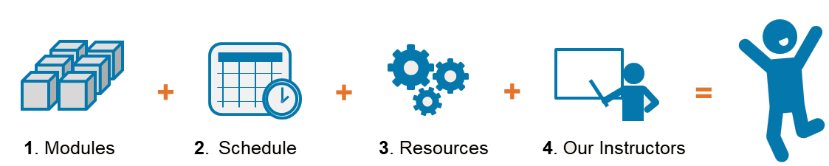
The Winning Workshop Set up

Slide 11


Workshop Module Structure
Training Webinar
Step-by-Step Software Demos
Exercises
Ask Questions

Slide 12

The Mechanics of the Workshop:
Eight webinars each on one main topic
Attend live lectures and/or watch recordings
Download a pdf copy of the slides
The Training Webinar

Slide 13
The Mechanics of the Workshop:
When you attend live:
Ask questions anonymously
During and at the end
The Training Webinar
Notes:
If attending the lecture live:
Attendees muted to reduce background noise.
Attendees can ask questions during the presentation by typing into the comment box.
Only the instructor can see the questions.
The questions will be read out loud so those in attendance and those watching the recordings will know the question. The name of the person asking the question is not named.
Instructor will stop at the end of each section to answer the questions. At times, the questions will be answered when submitted.

Slide 14

The Mechanics of the Workshop:
Syntax to repeat all training examples in R, Stata, SPSS and SAS.
Video demonstrations of menus and a walk through of the syntax
Participants can download the data and syntax to all software packages
Step-by-Step Software Demos
Notes:
At the end of the lecture the syntax/code to repeat everything shown in the lecture will be available in R, Stata, SPSS and SAS.
There will be videos explaining how to use the menu bars when discussing a new topic when appropriate (some software require more menu explanation than others). The videos will also explain how the syntax/codes are used and all special options used.
Participants can download the syntax/code to all software packages.

Slide 15

The Mechanics of the Workshop:
Exercises to practice what you learned
Downloadable syntax to do the exercises in R, SAS, Stata, SPSS
Answers sheets so you check your work
Exercises
Notes:
Exercises will be available after the lecture to practice the concepts taught during the lecture.
Answers and the syntax/code to answer the questions will be available at the same time.
You can download the answers and syntax/code to all software packages if you want.

Slide 16

The Mechanics of the Workshop:
Forum
Write in questions on our private forum. The goal is to answer all questions within 24 hours
Read and learn from others’ questions
Access forum for up to a year
Ask Questions
Notes:
All participants (live and those watching the recordings) will be able to write in questions through a forum. The goal is to answer all questions within 24 hours.
All participants will be able to read and learn from other participants’ questions.
Everyone can ask questions on the forum for up to a year.

Slide 17
The Mechanics of the Workshop:
Q&A sessions
Eight one hour weekly live Q&As.
Can’t attend the Q&A live? Send in your questions and have them answered during the live Q&A.
Any software specific questions for all software packages covered in the workshop.
The Q&A sessions are recorded and will be available for viewing within 24 hours.
Ask Questions
©2018 Jeff Meyer | http://TheAnalysisFactor.com
Notes:
There are eight one hour weekly Q&A’s.
If you are unable to attend the Q&A live, you can send in your questions in advance and have them answered during the live Q&A.
We will answer any software specific questions for all software packages covered in the workshop.
The Q&A sessions are recorded and will be available for viewing within 24 hours.

Slide 18

Workshop Resources
Bonus Videos
Probability Rules and Applications (1:34:32)
13 Steps to Running any Statistical Model (58:06)
Discrete Time Event History Analysis (01:26:54)
A Primer on Exponents & Logarithms for the Data Analyst (01:43:46)

Slide 19
Workshop Resources
Program Center Website
Calendar
Bonus Videos
Data Files and Descriptions
Q&A Recordings
Extra Reading
Support form
FAQ
Each Module:
Handouts
Recordings
Syntax Files
Software Demo Videos
Exercises and Answers

Slide 20
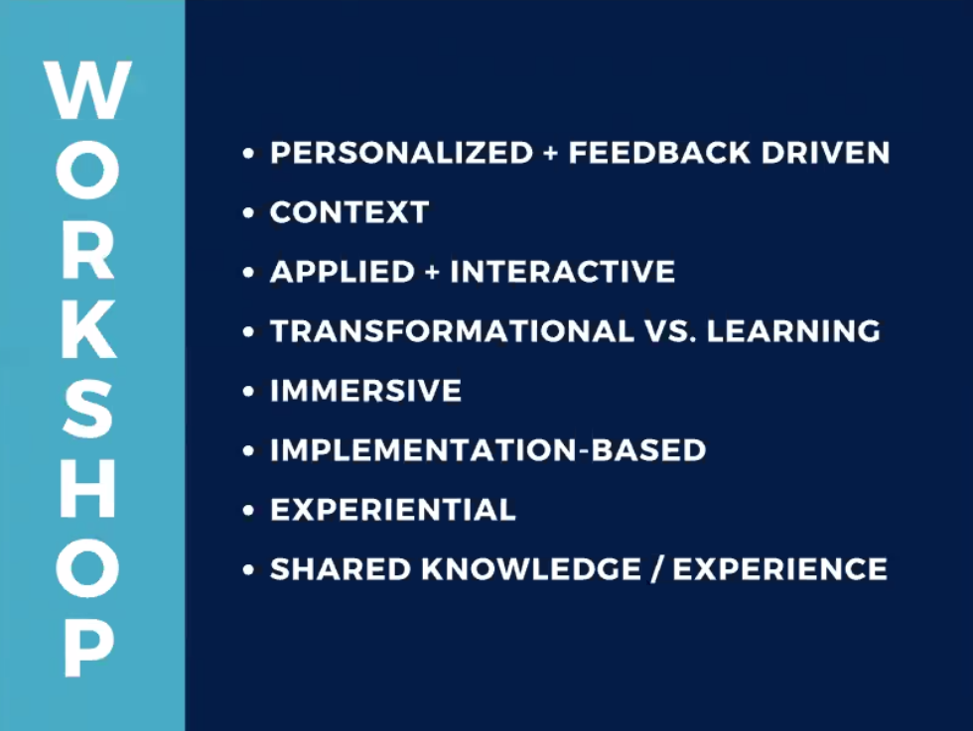
Book vs. Workshop

Slide 21

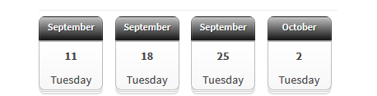
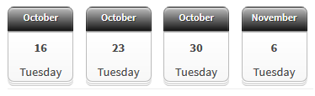
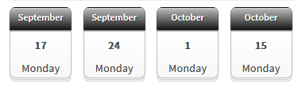
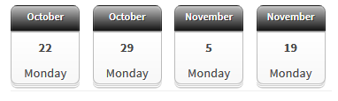
Workshop Schedule
Training webinars: Tuesdays, from 12 – 2pm (Eastern)
Q&A sessions: Mondays 12 – 1pm (Eastern)

Slide 22
Workshop Outline
Module 1: The Kaplan-Meier Curve
Constructing a Kaplan-Meier Curve
Censoring and Its Assumptions
Log Rank Test for Subgroup Comparisons

Slide 23
Workshop Outline
Module 2: The Hazard Function and the Cox Proportional Hazards Model
Definition of a Hazard Function
Constant Hazard vs Increasing or Decreasing Hazard
Steps to Run Cox Regression Models and Interpret Model Coefficients

Slide 24
Workshop Outline
Module 3: Planning and Data Management Issues
Data Set Up for Survival Analysis
Compute and Compare Power
Problems with Date Variables

Slide 25
Workshop Outline
Module 4: Cox Model: Model Fitting and Diagnostics for the Cox Model
Multiple Predictor Variables
Risk Adjustment
Proportional Hazards

Slide 26
Workshop Outline
Module 5: Parametric Models
Comparing Hazard Functions for Popular Distributions
Interpreting Coefficients
Understanding Advantages and Disadvantages

Slide 27
Workshop Outline
Module 6: Time-Varying Covariates in a Cox Model
How to Code Data for Time-Varying Covariates
Fit Time-Varying Models
Interpreting the Results

Slide 28
Workshop Outline
Module 7: Frailty Models
Multiple Events per Patient
How to Define Random Effects
How to Fit and Interpret the Models

Slide 29
Workshop Outline
Module 8: Competing Risk Models
Multiple Events per Patient

Slide 30
You’re Ready for this workshop if:

Slide 31
Questions?
https://www.theanalysisfactor.com/survival-analysis-workshop/

